Slide 1
Finding a percentage with a multiplier
Task A: Reviewing percentages of amounts
Work out:
a) 51% of 980 =
b) 23% of 640 =
c) 62% of 120 =
18.2
499.8
d) 13% of 140 =
e) 3% of 40 =
f) 9% of 24 =
147.2
1.2
74.4
2.16
Task B: Using a decimal multiplier
Write the calculation showing the decimal multiplier.
You do not need to calculate the answer.
a) 56% of 389
b) 24% of 484
c) 16% of 563.1
= 0.56 × 389
d) 3% of 186.2
e) 33.3% of 475
f) 3.3% of 986
= 0.03 × 186.2
= 0.24 × 484
= 0.333 × 475
= 0.16 × 563.1
= 0.033 × 986

Slide 2
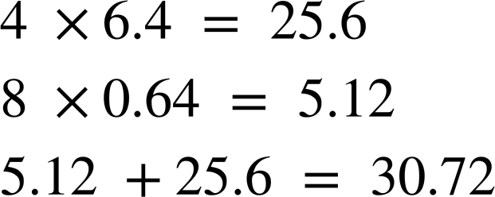
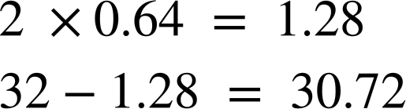
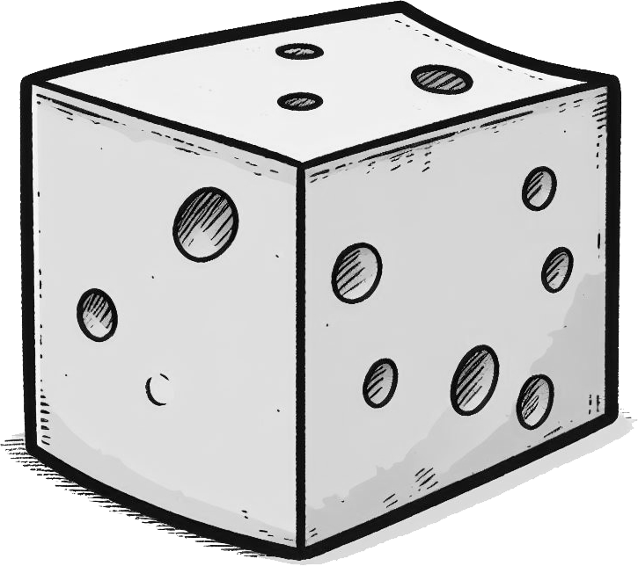
Finding a percentage with a multiplier
2) Work out:
a) 27% of 560
b) 18% of 244
c) 6% of 94
= 0.27 × 560 = 151.2
= 0.18 × 244 = 43.92
= 0.06 × 94 = 5.64
3) Can you explain the strategy behind each student’s working out for finding 48% of 64?
Alex has found 10% and is multiplying by 4 to give 40%.
Then Alex has found 1% and is multiplying by 8 to give 8%.
Alex
He has then summed 40% and 8% to make 48% which is 30.72
Sam has found 1% and is multiplying by 2 to give 2%.
The 32 represents 50% of the 64.
Sam has subtracted 2% from 50% to make 48% which is 30.72
Sam
4) A hard cheddar cheese contains 37% water, 33% fat, 23% protein, 3.5% carbohydrates, and 3.5% minerals and other compounds.
From a 250g block of cheese, work out how many grams there are of:
= 0.37 × 250 = 92.5 g
Water
Fat
Protein
= 0.33 × 250 = 82.5 g
= 0.23 × 250 = 57.5 g
Mathematics in Education and Industry.
v2.3

